Slide 1
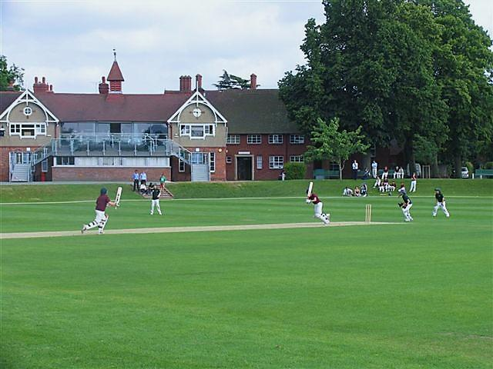
Shropshire Playing Fields Association
Open Space Needs Assessments
David Kilby
SAPCA Conference

Slide 2
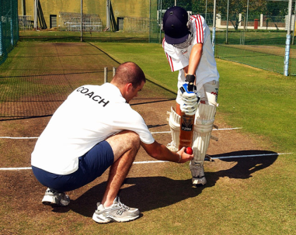
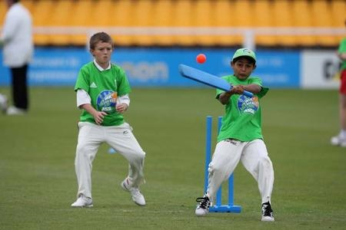
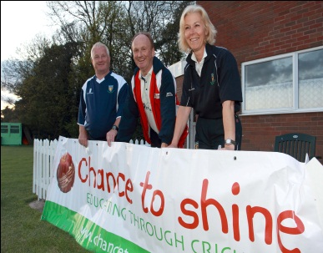
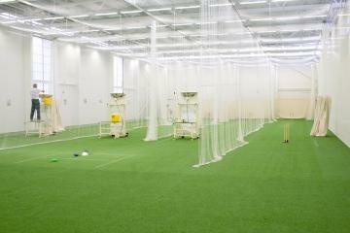
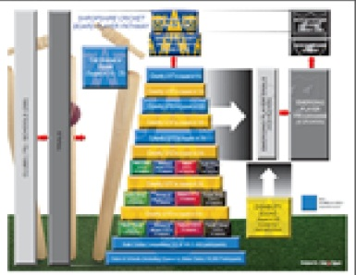
SPORT
PLAY
RECREATION
OPEN SPACES
OPPORTUNITIES
National Planning Policy (Paragraph 73)
‘Access to high quality open spaces and opportunities for sport and recreation can make an important contribution to the health and well-being of communities.
Planning policies should be based on robust and up-to-date assessments of the needs for open space, sports and recreation facilities and opportunities for new provision.
The assessments should identify specific needs and quantitative or qualitative deficits or surpluses of open space, sports and recreational facilities in the local area.
Information gained from the assessments should be used to determine what open space, sports and recreational provision are required.’.’

Slide 3
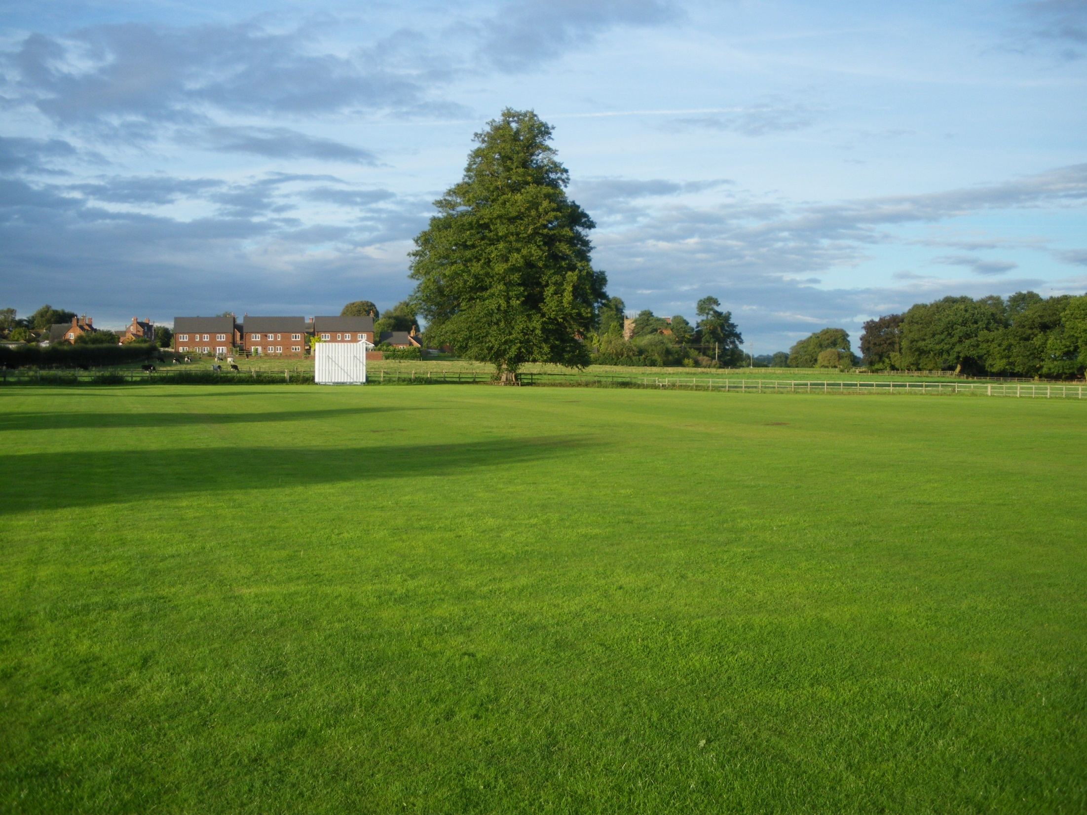
The Government, within their Planning Practice Guidance, refer planning authorities to Sport England ‘s
“Assessing needs and opportunities guide for outdoor sport facilities
The guide, in part, seeks to replace the previous document:
“Assessing needs and Opportunities: a Companion Guide to Planning Policy Guidance Note 17 (PPG17)” (ODPM/DCLG, 2002) which was cancelled by the Government on the 6th March 2014.
It is important to note, at this point , that the guide only focuses on the need for formal sport and that the guide according to Sport England ,“is not intended to be used for assessing play, informal activities or wider open space needs.”

Slide 4
A Planning Tool
SPORT
PLAY
RECREATION
OPEN SPACES
OPPORTUNITIES
Needs assessments form the basis of a number of applications in a planning and non-planning setting, including:
Sport, play and recreation facility development.
Planning policy development.
Infrastructure planning (including the use of Community Infrastructure Levy Funds).
Developing an evidence base for funding bids and to influence investment decisions.

Slide 5
Robust up-todate evidence
SPORT
PLAY
RECREATION
OPEN SPACES
OPPORTUNITIES
When considering the robustness of a needs assessment Sport England make it clear that assessments should be no more than 3-years old to account for changes and to ensure, the supply and demand analysis is still valid and robust.
They add `whilst it may not be necessary to update the whole evidence base, updating of key information will be required where evidence is over 3-years old’.

Slide 6
North West England Local Planning Authorities
SPORT
PLAY
RECREATION
OPEN SPACES
OPPORTUNITIES
Research of over 20 local planning authorities across the North-West of England would suggest that…
> Many do not have robust up-to-date needs
assessments in place, as required by the national planning policy framework.
> Many are using playing pitch strategies instead, to inform their policy planning.
> Many are using out-dated open space needs assessments, based on the old PPG17 typology.

Slide 7
Question
If no needs assessment has been done, no play strategy been done, and no funds allocated towards play facility provision in an area…
Who are the losers?
And what can be done about it?

Slide 8
PLAY
SPORT
RECREATION
OPEN SPACES
OPPORTUNITIES
It should be noted that it is not only local planning authorities that can provide a local open space needs assessment.
Town and Parish Councils, as well as local sport clubs, schools and community groups could be proactive in initiating such a need assessment, depending on their own objectives.

Slide 9
PLAY
SPORT
RECREATION
OPEN SPACES
OPPORTUNITIES
The Playing field movements focus is towards enabling the right facilities to be provided in the right places.
Sport England aims to ensure positive planning for sport based on robust and up-to-date assessments of need for all levels of sport and all sectors of the community.

Slide 10
PLAY
SPORT
RECREATION
OPEN SPACES
OPPORTUNITIES
Sport England, Fields In Trust, and the Playing Field Movement share common planning objectives.
They all seek to PROTECT facilities from loss, as a result of redevelopment;
ENHANCE existing facilities through improving their quality, accessibility and management;
And support the PROVISION of new facilities, which meet participation demands now and in the future.

Slide 11
Playing Pitch Strategies
Our evidence would seem to indicate that where an open space needs assessment has not been done some local planning authorities are relying on “playing pitch strategy documents” to inform planning policy makers.

Slide 12
PLAYING PITCH STRATEGY?
SPORT
PLAY
RECREATION
OPEN SPACES
OPPORTUNITIES
We believe a playing pitch strategy should not be used as a substitute for a needs assessment.
An open space needs assessment is an essential planning tool meeting national planning policy guidelines.
A playing pitch strategy is best used to support the needs and interests of individual sports groups and governing bodies of sport.

Slide 13
Playing Pitch Strategy Limitations
A playing pitch study following Sport England guidelines often encompasses an assessment for the requirements of just a few key outdoor sports.
football, cricket, rugby and hockey.
Tennis, Netball, Bowls
It does not look at secondary usage of a playing field.

Slide 14
PLAY
SPORT
RECREATION
OPEN SPACES
OPPORTUNITIES
The Playing field movements focus is towards enabling the right facilities to be provided in the right places.
Sport England aims to ensure positive planning for sport based on robust and up-to-date assessments of need for all levels of sport and all sectors of the community.
We believe there is sufficient evidence to suggest that this is not always happening in many of our local communities today.
Thank you for listening

Slide 15
PLAY
SPORT
RECREATION
OPEN SPACES
OPPORTUNITIES
PLAY
Play is not a separate activity, but is an integral part of existing activities.
Reasonable to assume that play is an integral part of sport and recreation.
Therefore play needs to be understood and applied in partnership with each activity, rather than in isolation.
(Wolfendon Report: 1960)

